Slide 1
Chapter 2
Network
Models

Slide 2
Chapter 2: Outline
2.1 Protocol Layering
2.2 TCP/IP Protocol Suite
2.3 OSI Model

Slide 3
Chapter 2: Objective
The first section introduces the concept of protocol layering using two scenarios.
The section also discusses the two principles upon which the protocol layering is based.
The first principle dictates that each layer needs to have two opposite tasks.
The second principle dictates that the corresponding layers should be identical. The section ends with a brief discussion of logical connection between two identical layers in protocol layering.
Throughout the book, we need to distinguish between logical and physical connections.

Slide 4
Chapter 2: Objective
The second section discusses the five layers of the TCP/IP protocol suite. We show how packets in each of the five layers (physical, data-link, network, transport, and application) are named. We also mention the addressing mechanism used in each layer. Each layer of the TCP/IP protocol suite is a subject of a part of the book. In other words, each layer is discussed in several chapters; this section is just an introduction and preparation.
The third section gives a brief discussion of the OSI model. This model was never implemented in practice, but a brief discussion of the model and its comparison with the TCP/IP protocol suite may be useful to better understand the TCP/IP protocol suite. In this section we also give a brief reason for the OSI model’s lack of success.

Slide 5
2.1 Protocol Layering
A protocol defines the rules that both the sender and receiver and all intermediate devices need to follow to be able to communicate effectively.
When communication is simple, we may need only one simple protocol.
When the communication is complex, we need a protocol at each layer, or protocol layering.

Slide 6
2.1.1 Scenarios
Let us develop two simple scenarios to better understand the need for protocol layering.
In the first scenario, communication is so simple that it can occur in only one layer.
In the second, the communication between Maria and Ann takes place in three layers.

Slide 7
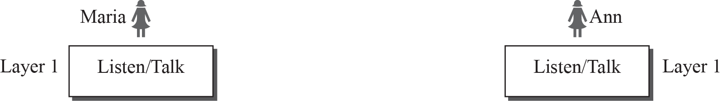
2.1.1 Scenarios
Single-Layer Protocol
  Maria and Ann can speak or listen

Slide 8
2.1.1 Scenarios
Three-Layer Protocol
  Ann moves to other city very far from Maria.
  They want to communicate using regular mail.
  The mails are translated using encryption or decryption technique.
  The communicate between Ann and Maria takes place in three layers.

Slide 9
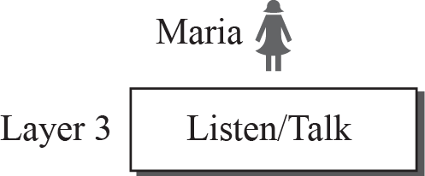
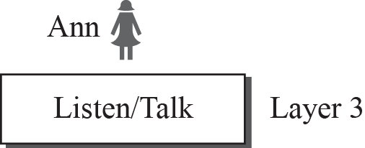
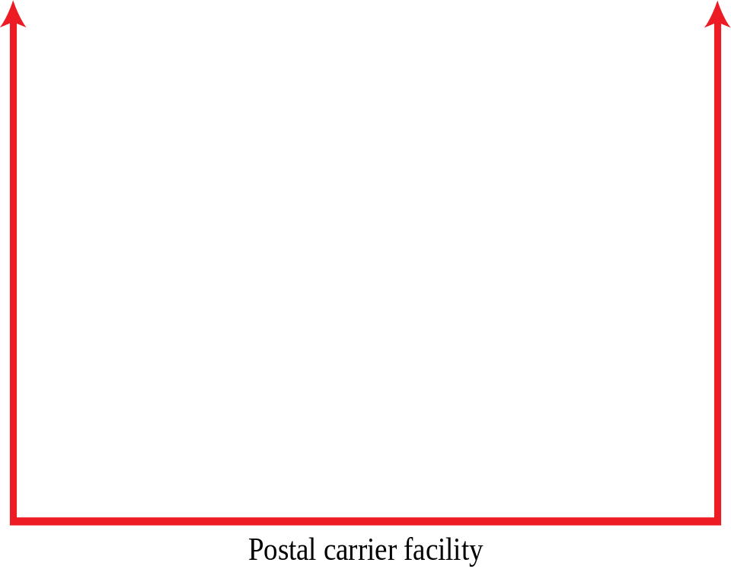


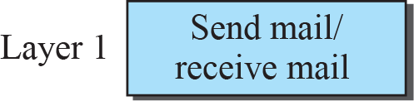
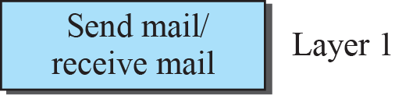
2.1.1 Scenarios
Three-Layer Protocol

Slide 10
2.1.2 Principles of Protocol Layering
Two principles of protocol layering.
The first principle : Each layer is able to perform two opposite tasks in bidirectional communication.
  Listen/Speak, Give/Take, Send/Receive,
  Encryption/Decryption.
The second principle : The two objects under each layer at both sites should be identical.
  Plain text letter, Cipher text, Enveloped mail

Slide 11
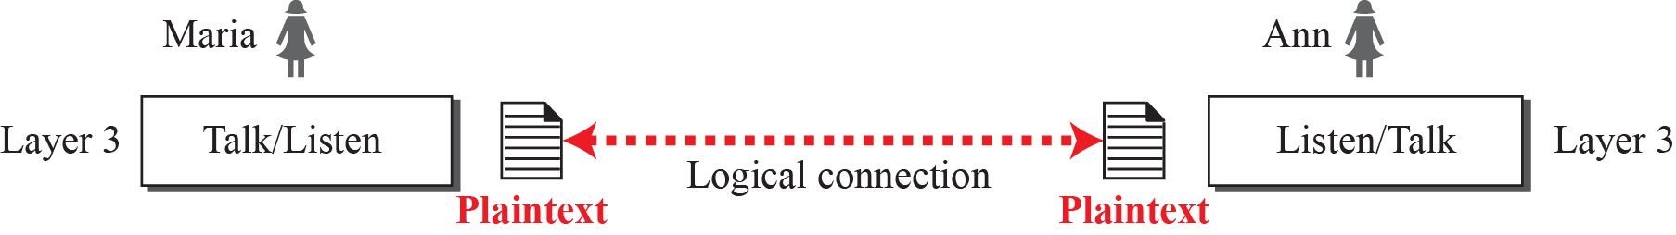
2.1.3 Logical Connections
Logical connection between peer layers means layer-to-layer communication.

Slide 12
2.2 TCP/IP Protocol Suite
Layers in the TCP/IP protocol suite

Slide 13
2.2.1 Layered Architecture
How the layers in the TCP/IP protocol suite are involved in communication between two hosts?
We assume that we want to use the suite in a small internet made up of three LANs (links), each with a link-layer switch.
We also assume that the links are connected by one router, as shown in next slide.

Slide 14
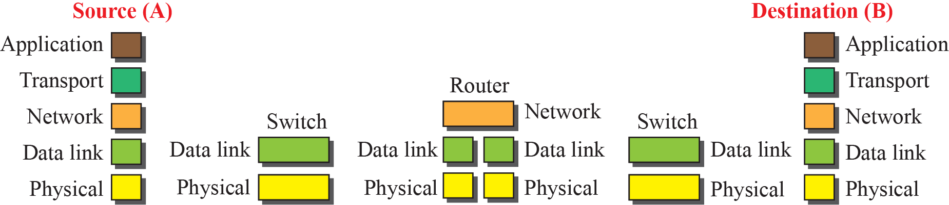

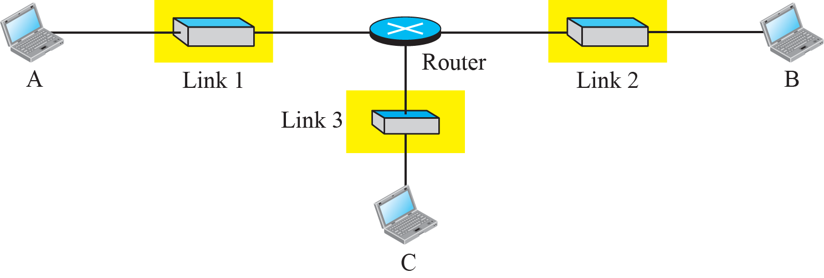
2.2.1 Layered Architecture
Communication through networking devices from source(A) to destination(B).

Slide 15
2.2.1 Layered Architecture
Computer A communicates with computer B.
Five communicating devices
  Source and destination host, two link layer switch, router.호스트
The two hosts are involved in all five layer.
The router is involved in three layers.
The link-layer switch is involved in three layers.

Slide 16
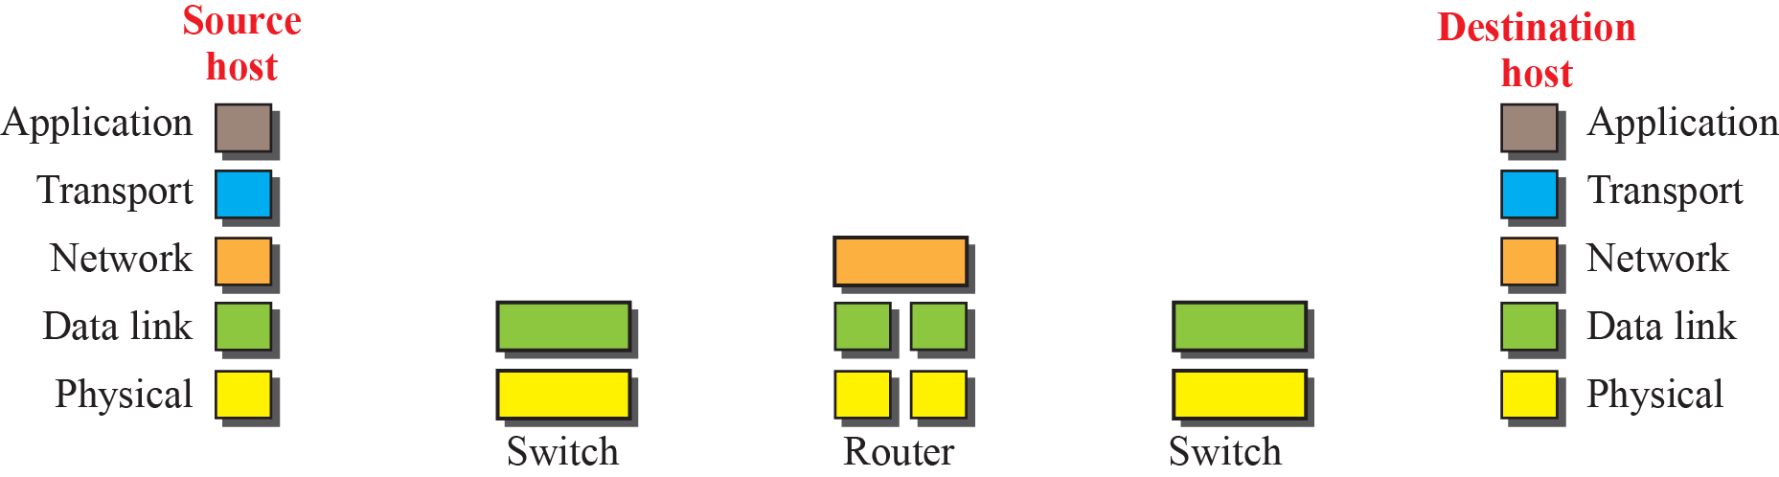
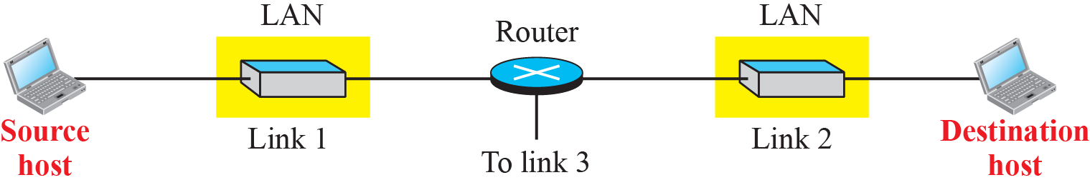
2.2.2 Layers in the TCP/IP Protocol Suite
Logical connections between layers in TCP/IP
Logical Connections

Slide 17
2.2.2 Layers in the TCP/IP Protocol Suite
The functions and duties of layers in the TCP/IP
  The functions and duties of application, transport and network layer are between end-to-end.
  The functions and duties of datalink and physical layer are between hop-to-hop.
  Host(Computer) or Router is considered one hop.

Slide 18
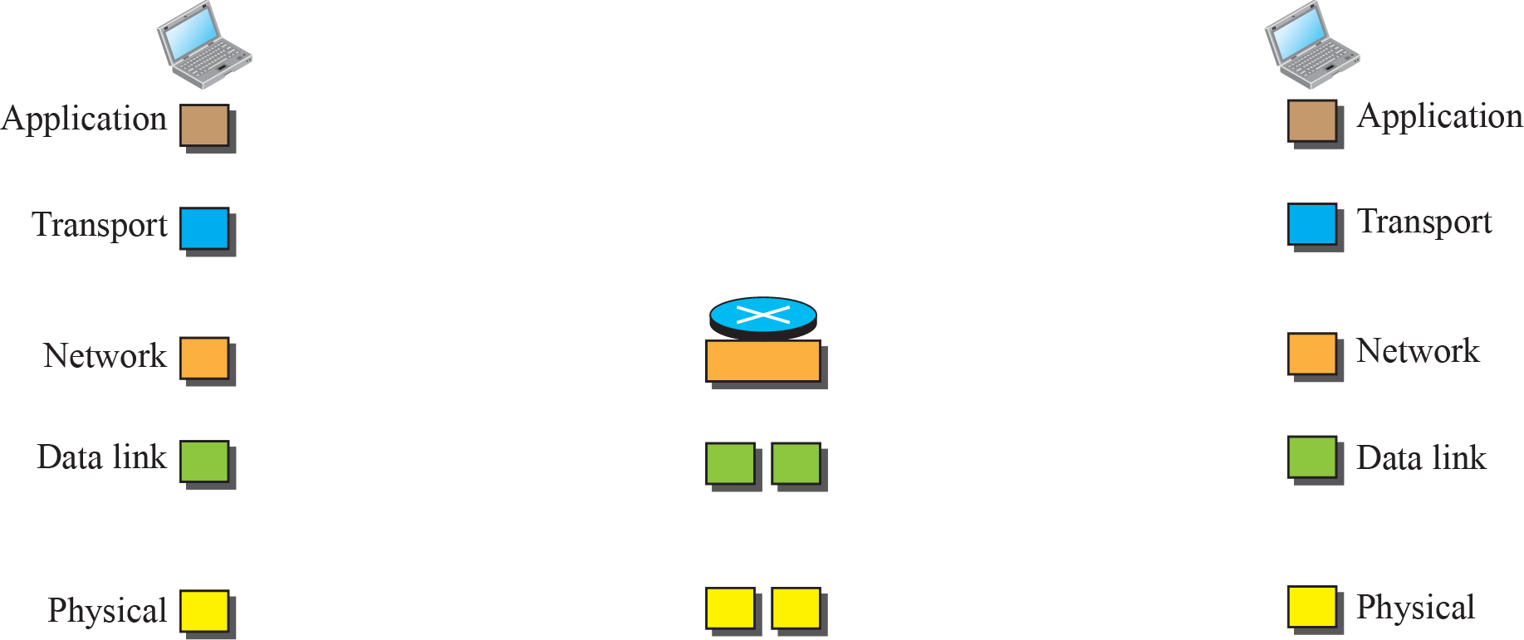
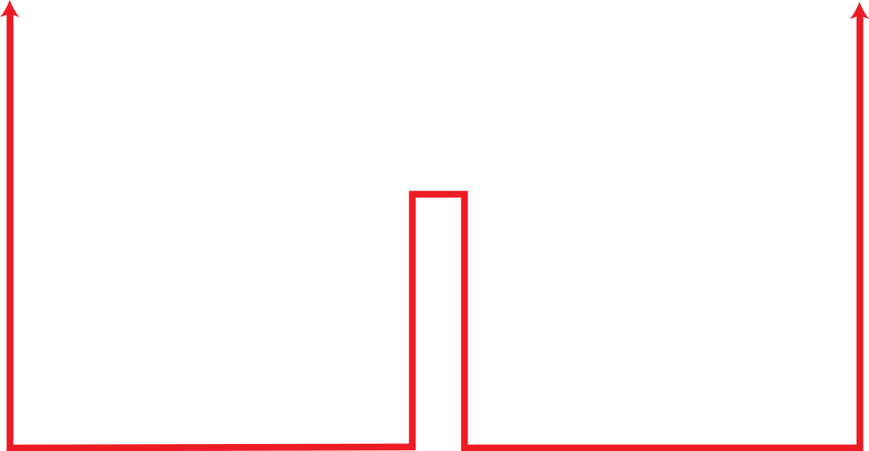
2.2.2 Layers in the TCP/IP Protocol Suite
Identical objects in the TCP/IP protocol suite
Identical objects (messages)
Identical objects (segment or user datagram)
Identical objects (datagram)
Identical objects (datagram)
Identical objects (frame)
Identical objects (frame)
Identical objects (bits)
Identical objects (bits)

Slide 19
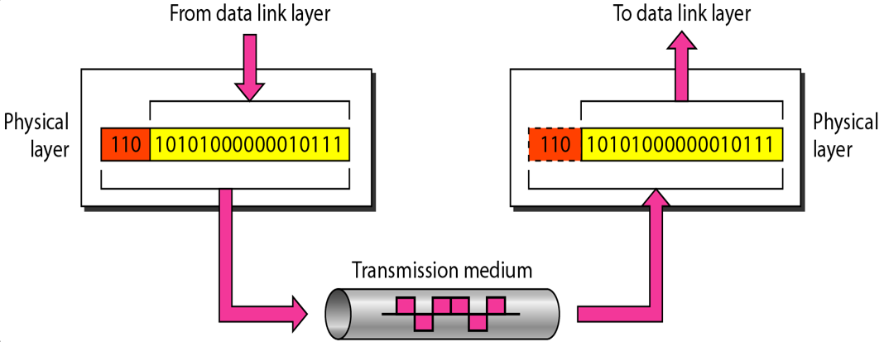
2.2.3 Description of Each Layer
Physical Layer
  Physical layer is responsible for movements of individual bits from one hop (node) to the next.
  This layer consists of the electronic circuit transmission technologies of a network.

Slide 20

2.2.3 Description of Each Layer
Data link Layer
  Data link layer is responsible for moving frames from one hop (node) to the next.

Slide 21
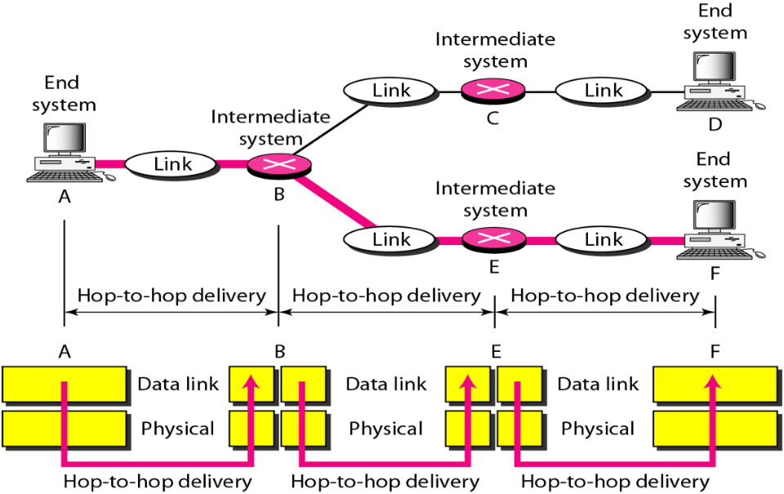
2.2.3 Description of Each Layer
Data link Layer : Hop-to-Hop delivery
  Data link layer transfers data between adjacent nodes in a WAN or between nodes on the same LAN segment.

Slide 22

2.2.3 Description of Each Layer
Network Layer
  The network layer is responsible for the delivery of individual packets from source to destination host.

Slide 23

2.2.3 Description of Each Layer
Network Layer : source to destination delivery
  Two basic functions: Host addressing and Packet routing

Slide 24

2.2.3 Description of Each Layer
Transport Layer
  Transport layer provides process-specific transmission channels for applications.

Slide 25

2.2.3 Description of Each Layer
Transport Layer
  The transport layer is responsible for the delivery
  of a message from one process to another.

Slide 26
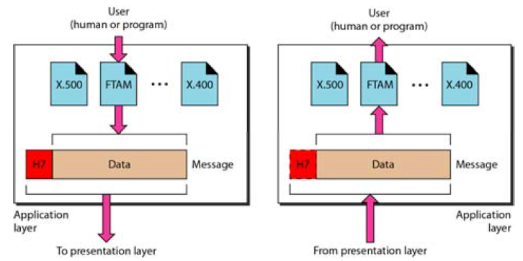
2.2.3 Description of Each Layer
Application Layer
  The application layer is responsible for
  providing services to the user.
  Hypertext Transfer Protocol (HTTP), File Transfer Protocol (FTP), Simple Mail Transfer Protocol (SMTP), the Dynamic Host Configuration Protocol (DHCP) …

Slide 27
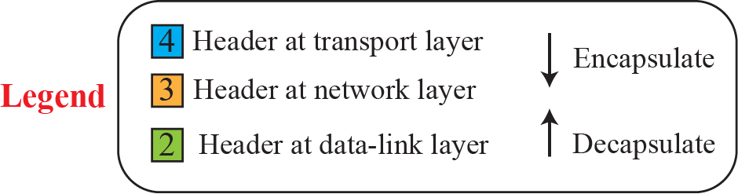
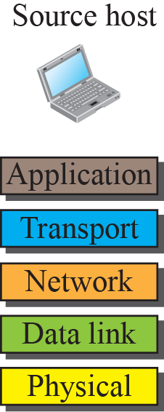
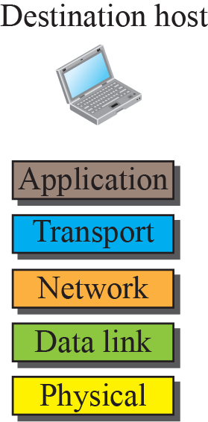
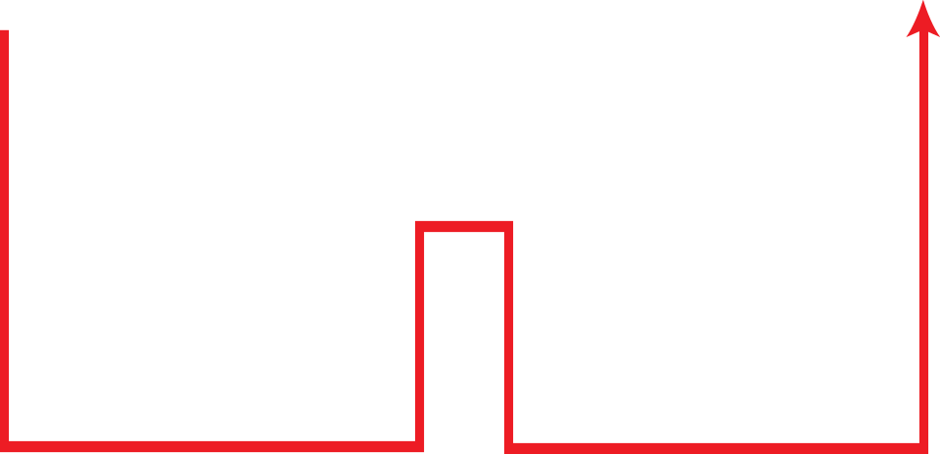
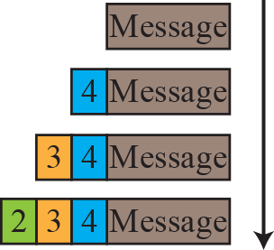
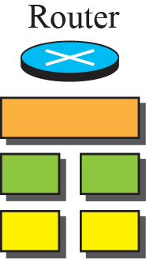
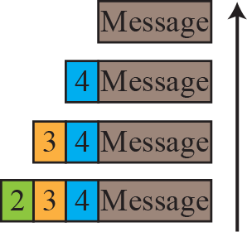
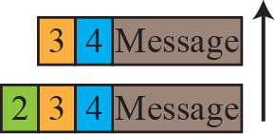
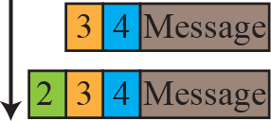
2.2.4 Encapsulation and Decapsulation
The important concepts in protocol layering
  Encapsulation at the source host
  Decapsulation and Encapsulation at the router
  Decapsulation at the destination host

Slide 28
2.2.5 Addressing
There exists logical communication between pairs of layers.
Any communication that involves two parties needs two addresses: source and destination address.
Although TCP/IP has five layers, only four pairs of addresses are needed.
  Physical layer does not need addresses; the unit of data exchange at the physical layer is a bit, which definitely cannot have an address.

Slide 29


2.2.5 Addressing
Addressing in the TCP/IP protocol suite

Slide 30
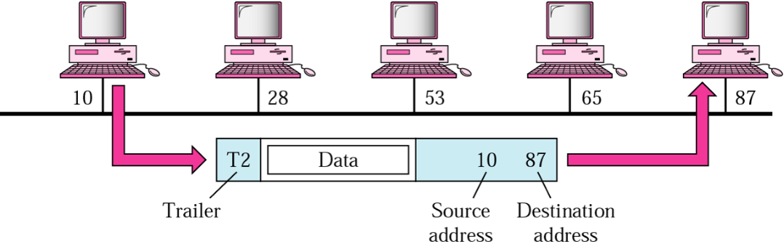
2.2.5 Addressing
Link-layer Addresses
  Locally defined addresse.
  They defines a specific host or router in a LAN or WAN.

Slide 31
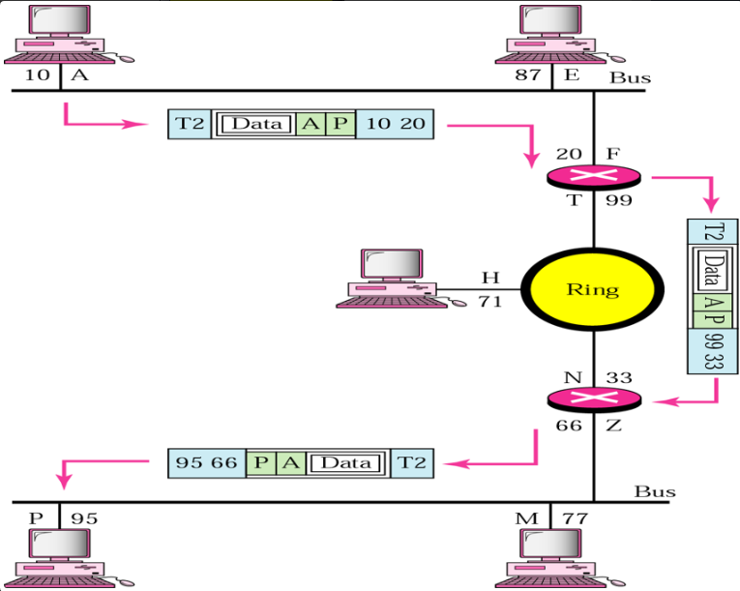
2.2.5 Addressing
Network Layer Addresses : Logical Addess
  The addresses are global, with the whole Internet as the scope
  32-bit IP addresses are network layer addresses

Slide 32
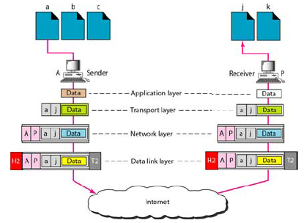
2.2.5 Addressing
Transport layer address : Port Number
  Port numbers are local addresses that distinguish between several programs running at the same time.

Slide 33
2.2.5 Addressing
Application layer address : Names(Specific Address)
  E-mail address, Uniform Resource Locator(URL) …
  kjs@knu.ac.kr
  http://www.knu.ac.kr

Slide 34
2.2.6 Multiplexing and Demultiplexing
TCP/IP protocol suite uses several protocols at some layers
  multiplexing at the source and demultiplexing at the destination.
Multiplexing
  A protocol at a layer can encapsulate a packet from several next-higher layer protocols (one at a time).
Demultiplexing
  A protocol can decapsulate and deliver a packet to several next-higher layer protocols (one at a time).

Slide 35
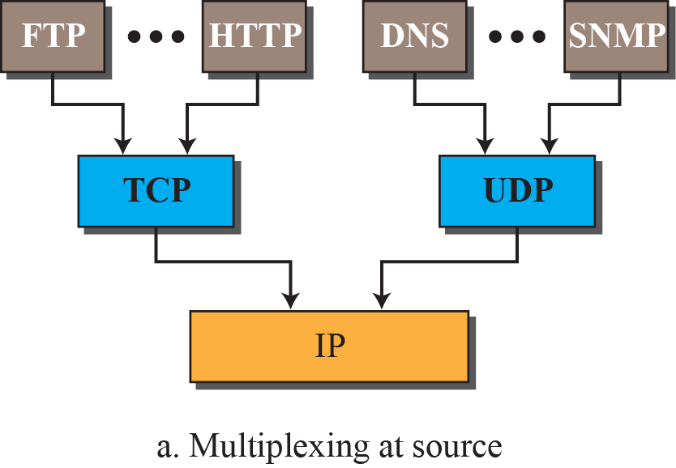
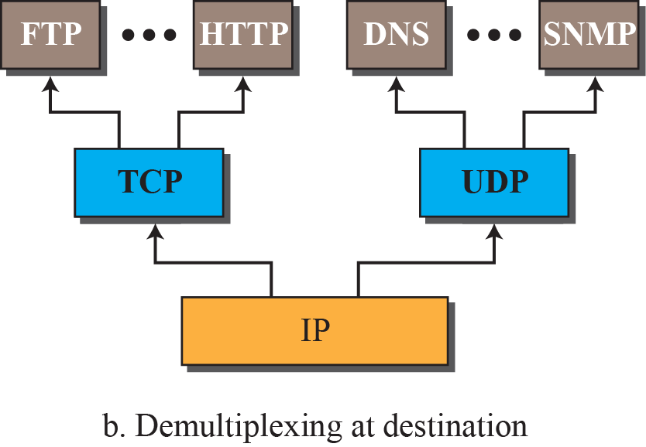
2.2.6 Multiplexing and Demultiplexing
concept of multiplexing and demultiplexing at the three upper layers.

Slide 36
2.3 OSI Model
In the late 1970s, the International Organization for Standardization (ISO) conducted a program to develop general standards and methods of networking.
Open Systems Interconnection(OSI) is an abstract model of networking.
  OSI promoted the idea of protocol layering, defining interoperability between network devices and software.
  ISO is the organization; OSI is the model.

Slide 37
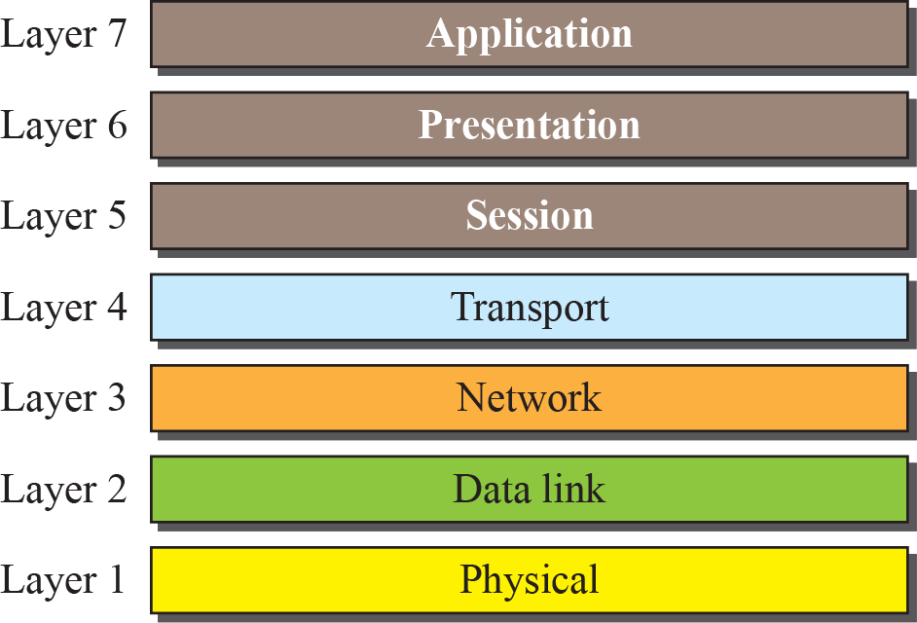
2.3 OSI 모델

Slide 38
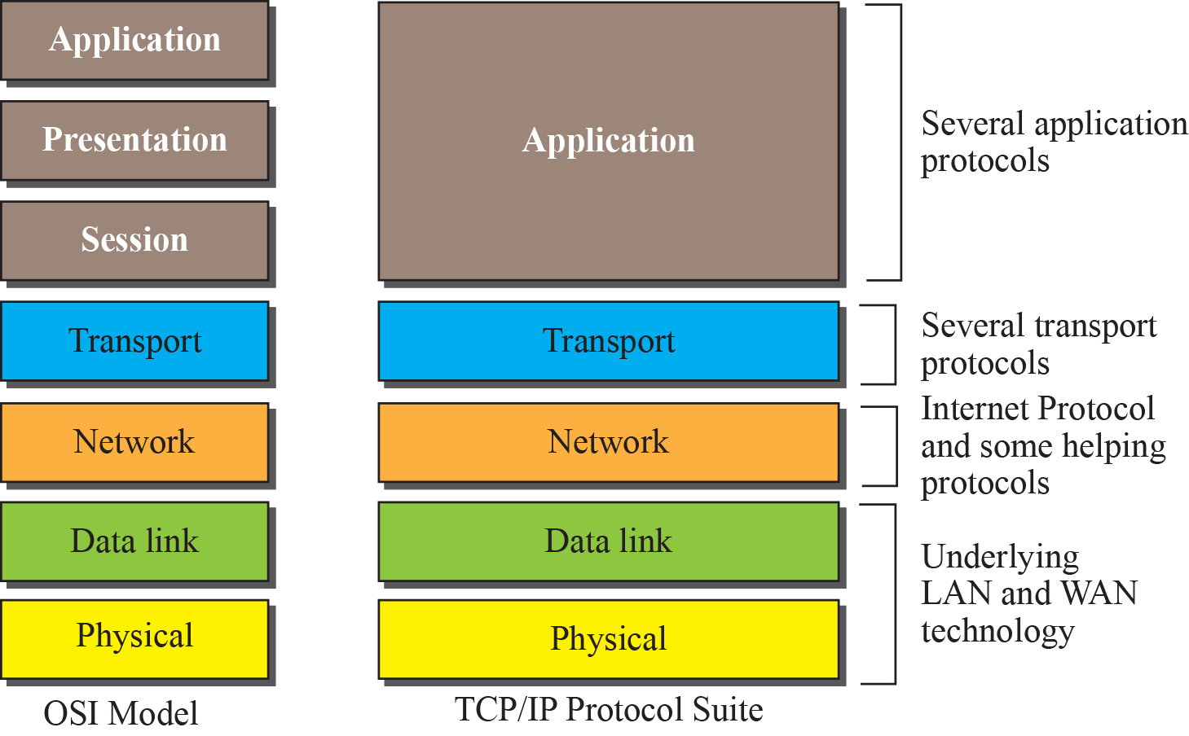
2.3.1 OSI versus TCP/IP
Session and Presentation layers are missing from the TCP/IP

Slide 39
2.3.2 Lack of OSI Model’s Success
The OSI model appeared after the TCP/IP protocol suite.
Most experts were at first excited.
However, OSI model did not replace TCP/IP for three reasons.
  OSI was completed when TCP/IP was fully in place.
  Some layers (Session and Presentation Layer) in the OSI were never fully defined.
  OSI did not show high enough level of performance to switch from TCP/IP to OSI model.

Slide 40

2.4 Summary
What is Protocol?
5 Layer of TCP/IP
Addressing Level
OSI Model & TCP/IP

Slide 41

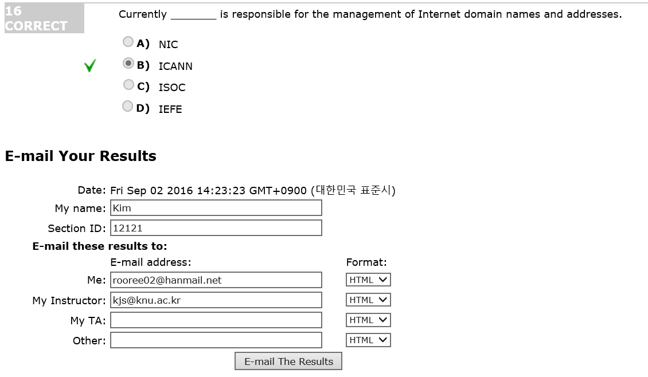
연습문제 풀이
DATA COMMUNICATION & NETWORKING, Global Edition, 5th Edition 에 관한 정보는아래 링크를 따라 가면 바로 연결됩니다.
http://highered.mheducation.com/sites/0071315861/sitemap.html

